Slide 1
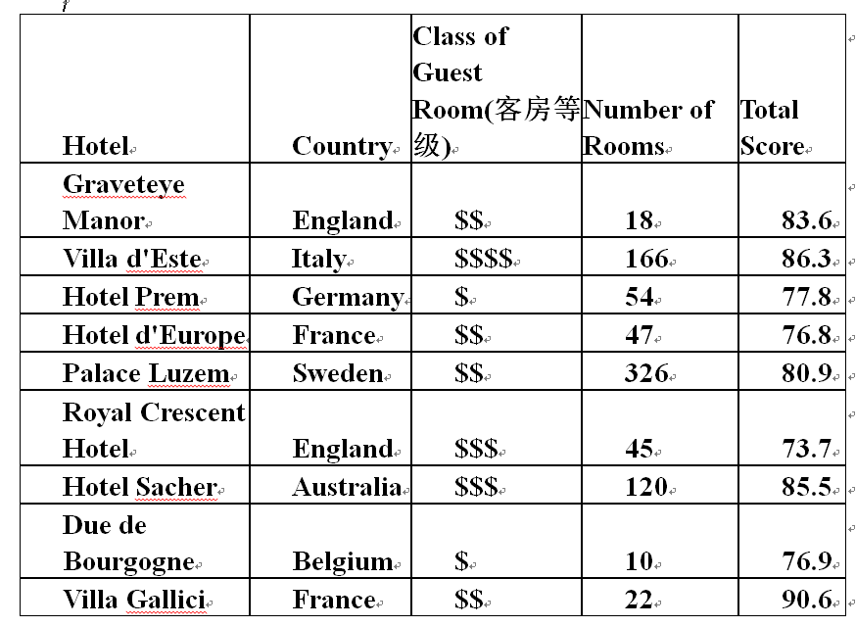
1.Conde Nast Traveler did an annual survey for its readers, to determine the best hotels in the world. The following table lists 9 hotels in Europe for the survey.
Questions:
Is this data set a population or a sample?
How many elements in this data set?
How many variables in this data set?
Which variables are qualitative and quantitative?

Slide 2
Solutions:
sample
9 elements
4 variables
Qualitative: Country------Nominal
Class of Guest Room---Ordinal
Quantitative: Number of Rooms----Discrete
Total Score----Continuous

Slide 3
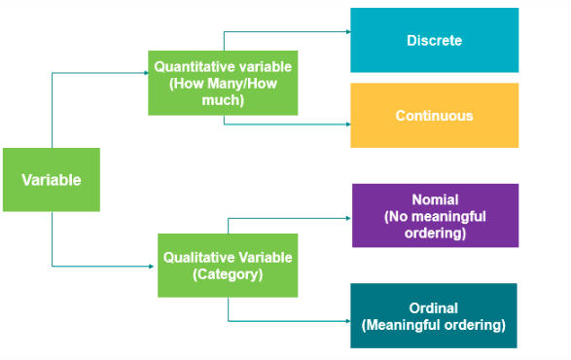


Different types of variables:

